Slide 1
Ice cream data analysis on Yelp
STAT628 Group 2, Jingyun Jia, James Wan, Ziao Zhang

Slide 2
Data Pre-processing
The ratings are discrete integers from 1 to 5. In order to build a more precise model, we use z scores to place them on a common scale. The formula is as follows:
Z=(X-μ)/σ, where X is the rating, μ is the mean, σ is the standard error.

Slide 3
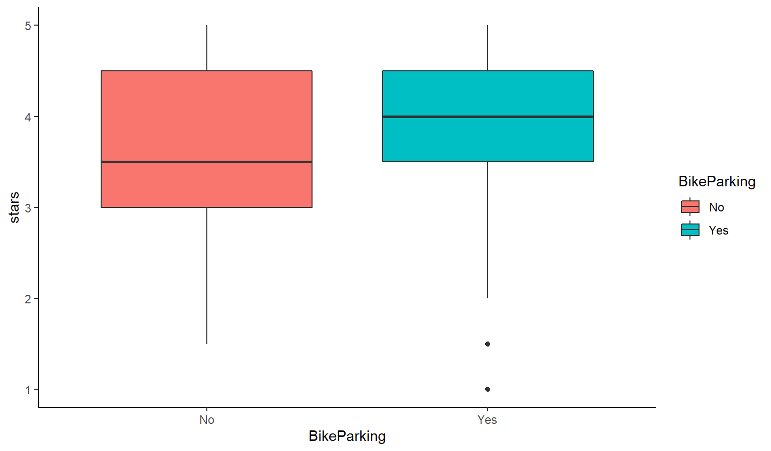
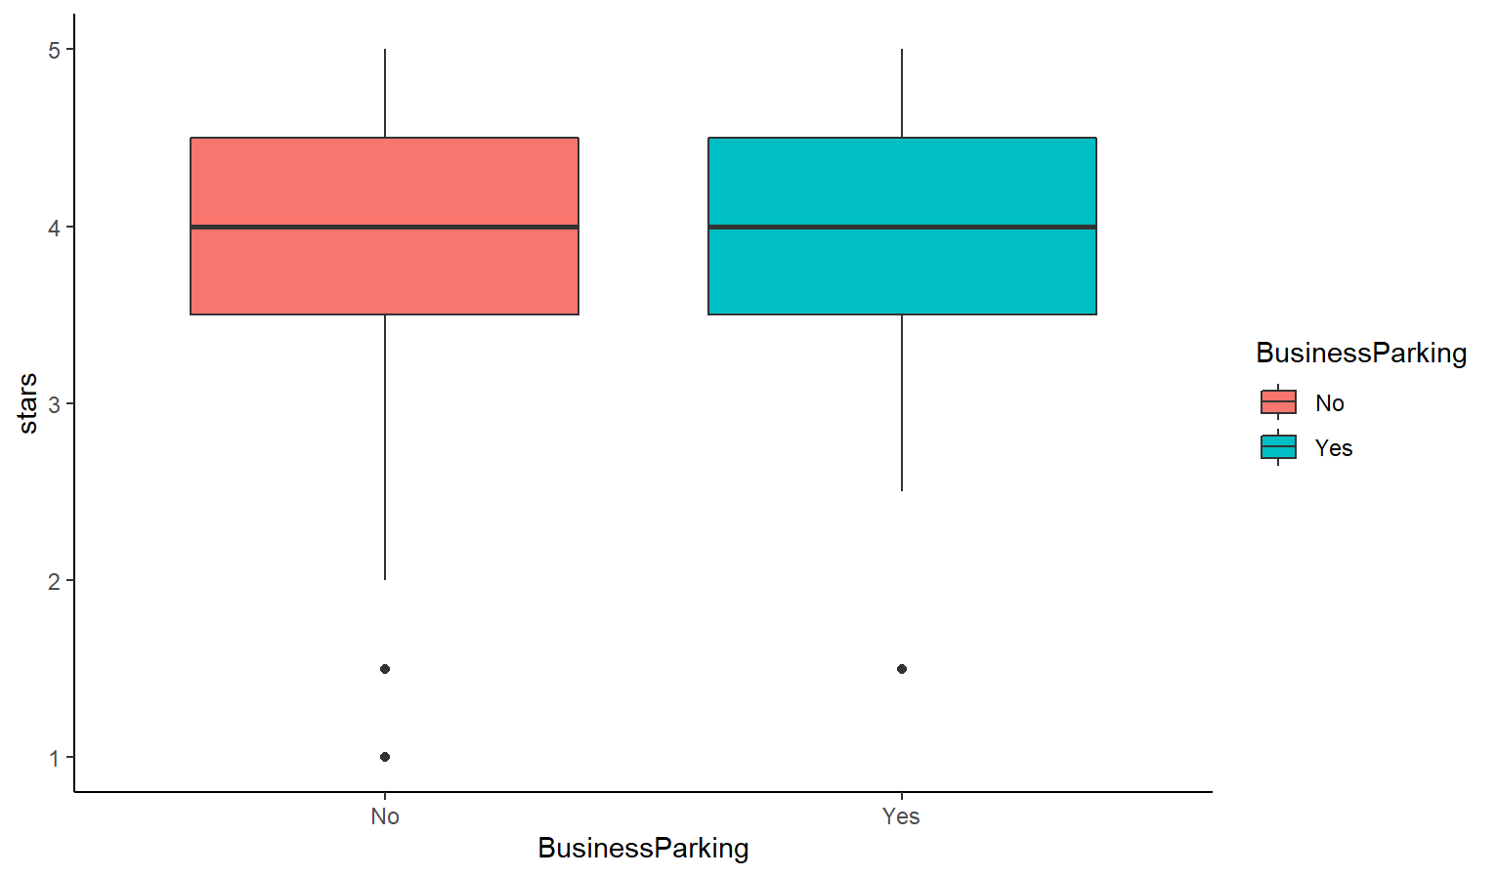
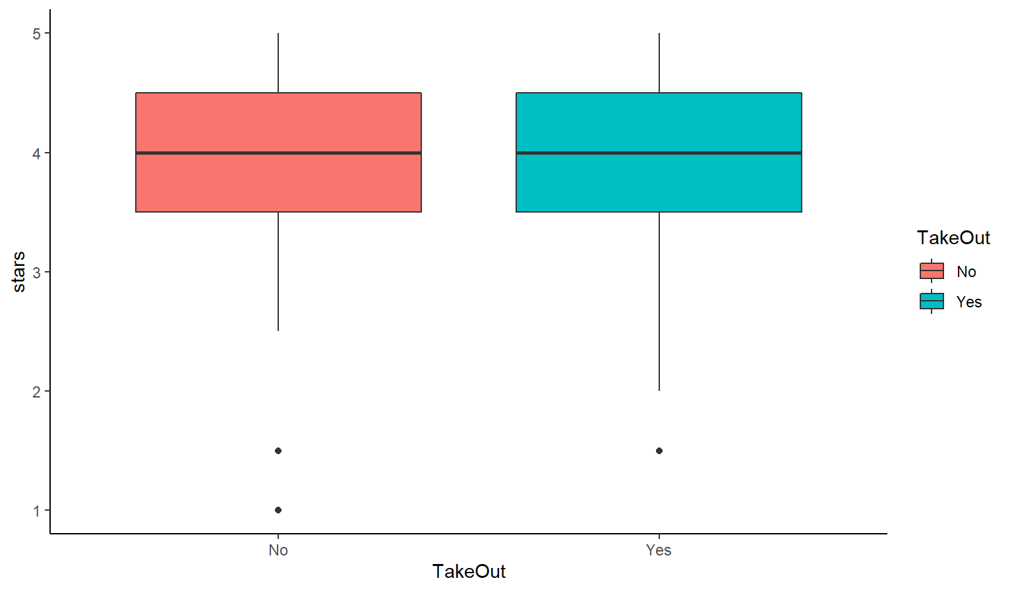
Exploratory Data Analysis
Bike Parking
Business Parking
Take-out service

Slide 4
Key Findings
Bikeparking and waffle can help improve the ratings significantly.

Slide 5
Statistical Model
For business dataset, we built an Anova analysis.
Attribute | P value
Bike Parking | 5e-9
Takeout | 0.1
Business Parking | 0.01

Slide 6
Statistical Model
For review dataset, we fitted a linear regression model.
Type | Coefficient | P value
Cone | 0.05 | 4e-8
Shake | -0.11 | 0.02
Sundae | 0.05 | 7e-6
Waffle | 0.31 | 0.04
Slush | -0.28 | <2e-16

Slide 7
Statistical Model
The formula is as follows:
Rating(z score)=0.05*cone-0.11*shake+0.05*sundae+0.31*waffle-0.28*slush-0.13
Or:
Rating(1-5)=0.06*cone-0.14*shake+0.07*sundae+0.37*waffle-0.37*slush+3.87

Slide 8
Recommendations
Pay attention to the surroundings -- near the bike parking area
Roll out more different kinds of waffle ice cream or make it become a specialty

Slide 9
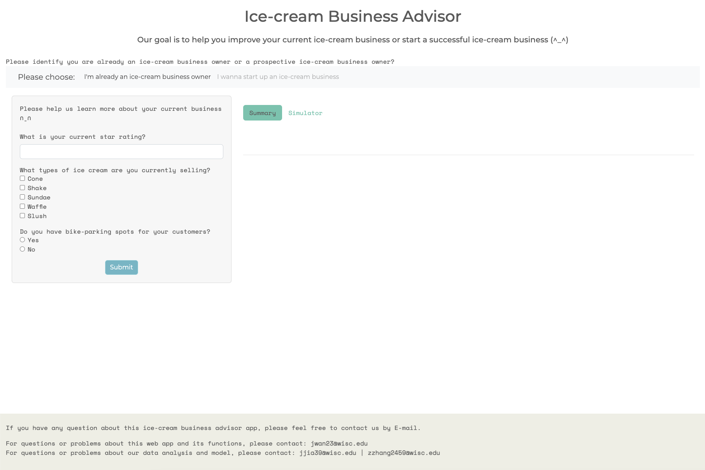
Shiny
https://jameswanjh.shinyapps.io/shiny/

Slide 10
Thank you!

